Slide 1

KeyBank Analytics and Quantitative Modeling
Rotational Analyst Program
Interview Case Studies

Slide 2
Overview
The purpose of the case study is to enable KeyBank to evaluate your problem-solving abilities, thought processes, and quantitative skills. While the interview day will include traditional Question and Answer interviews, you will also be required to present a case study of your choosing to one of the interview teams.
You may use any software or publicly available information you wish to complete this assignment; candidates typically spend 4-8 hours creating their project depending on their prior experience and desired complexity.
Step One: Review the different case study options on the following pages of this document.
Step Two: Select one of the case studies and complete the tasks outlined in the description.
Step Three: Prepare a brief, 3-4 slide deck describing your analytical work. You will present your work to Key’s quantitative and analytics managers in a 30 minute session during your interview. Your presentation should be 20 minutes long leaving approximately 10 minutes for follow-up questions. Generally, the framework should include:
Restatement of the problem
Data considerations
Overview of your method/design
Strengths and weaknesses of the approach
Step Four: Before the day of the interview, email your presentation deck to the following to allow preparation of materials for the interviewers:
pete_g_catavolos@keybank.com bradley_t_seadler@keybank.com

Slide 3
Option 1: Industry/Market Analytics
As markets shift, new opportunities arise for financial institutions to facilitate business ventures through intelligent and thoroughly researched lending strategies.
Provide a proposition for a company, industry, market segment, geographic region, emerging technology, or lending strategy that you believe would be an interesting future business for KeyBank to become involved with.
In your proposal, use publicly available information, such as data from stock prices, research reports, investor updates (such as those available on companies websites like http://investor.key.com/), or other sources to support your views analytically.

Slide 4
Option 2: Predictive Insights
As a lender, KeyBank offers clients access to money in the form of loans or lines of credit with the understanding that some customers may fail to repay it. In order to maintain a profitable business, this expected loss must be factored into the credit decision-making process by pricing the risk into the interest rate charged to each client.
To this end, many Quantitative Analysts at KeyBank assist in the design, testing, implementation, and validation of models to assess credit risk characteristics of our borrowers and predict expected loss.
Option 2 focuses on the concept of delinquency. Delinquency rate is a pivotal credit risk metric used to assess the quality and health of KeyBank’s credit portfolios. As an example, a customer who has paid all prior months’ loan bills on time is considered current on their obligations. However, once that customer misses a payment for the first time they become delinquent. As the portion of the portfolio considered delinquent grows, investors and managers quickly take notice.
In this case study, you are tasked with predicting which customers from this month’s pool of “current” customers will become delinquent next month.
Requirements
Develop an analytical system or model to predict which Home Equity Loan (HELOAN) customers will become delinquent the following month. Please describe your method in sufficient detail so the interviewers fully understand your process. This can include your complete code, or a thorough description of data treatments and coefficients.
(Continued on next page)

Slide 5
Option 2: Predictive Insights (Cont.)
Data Overview
You are provided an Excel document including two fictionalized data sets related to Home Equity Loans (HELOAN) for which you will forecast delinquency. The two datasets, Borrower and Loans, are accompanied by a Data Dictionary to define any fields you may be unfamiliar with. The banking terminology follows generally accepted definitions which can also be found online. Six months of data are included, and your approach should be built such that it generalizes well to any given month. The data fields included are listed below:
Borrower
Account_Number
First_Name
Last_Name
Zip_Code
Country_Code
Income_Annual
Total_Mortgage_Balances
Total_HE_Balances
Num_Trades_Past_Due
Num_HE_Trades
Loans
Account_Number
Month
Product
FICO_Score_Original
FICO_Score_Current
Origination_Date
Maturity_Date
Commitments
Outstandings
LTV_Original
LTV_Current
Lien_Position
Day_Past_Due
Interest_Variability_Code
Collateral_Value
Payment_Amount
Origination_DTI
APR

Slide 6
Option 3: Sum Pathing
When tackling a problem, occasionally a simple brute force solution can be tempting rather than designing a flexible and efficient solution. This concept can be shown below:
By starting at the top of the pyramid of single digit numbers and moving only to adjacent numbers on the next row, the path that results in the largest sum is shown in red (24):
2
8 5
2 5 6
7 5 9 1
2 + 8 + 5 + 9 = 24
At that scale, you could simply check all options with pen and pencil. However, as the pyramid grows, the need for a more efficient solution becomes evident. Using the same rules shown above, design an efficient solution to find the path resulting in the largest sum of the two digit numbers through the pyramid provided (Pyramid.txt)
Solution: 2049

Slide 7
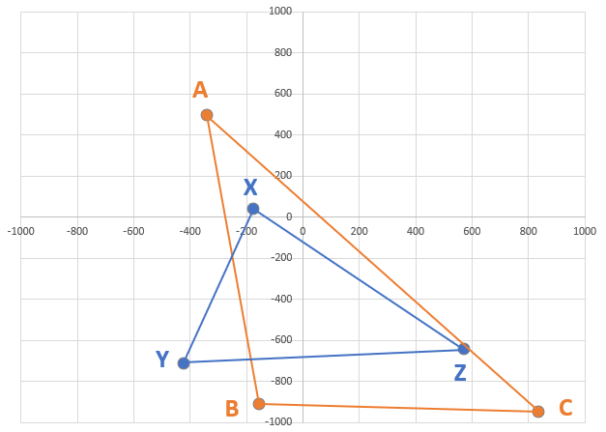
Option 4: Origin Containment
Any three points plotted at random on a Cartesian plane form a triangle. Consider the following two triangles:
ABC - A (-340, 495) B (-153, -910) C (835, -947)
XYZ - X (-175, 41) Y (-421, -714) Z (574, -645)
It can be verified that triangle ABC contains the origin (0,0), whereas triangle XYZ does not.
Using the provided file (Triangles.txt) containing the coordinates of one thousand triangles, find the number of triangles for which the interior contains the origin. Triangle ABC is the first record.
Solution: 270

Slide 8
Option 5: Tic Tac Toe Algorithm
Tic-Tac-Toe, or X’s and O’s, is a paper-and-pencil game where two players, X and O, take turns marking the spaces on a 3×3 grid. The player who succeeds in placing three of their marks in a horizontal, vertical, or diagonal row wins the game.
Imagine you and your friends have suddenly become extremely competitive Tic-Tac-Toe players. In an effort to save the thousands of pounds of paper used in your games, you have volunteered to design a digital form of the game for two human players. In order to accomplish this, you will need to design the underlying logic to evaluate the current state of the game at each turn.
Build an algorithm which covers all steps of any single turn of Tic-Tac-Toe. Your algorithm at a minimum should decide whose turn it is, the turns result, and allow for user input.

